Slide 1
Issues Paper on Corn Industry in the Philippines
FINAL REPORT PRESENTATION
22 July 2020
Asian Social Project Services, Inc.

Slide 2
OUTLINE OF PRESENTATION
Introduction
Methodology
Results and Discussion
A. Description of the Philippine corn industry
Supply chain and role of stakeholders
Possible competition issues at each stage of supply chain
Policies and regulations relevant to possible competition issues
Summary, Conclusions and Recommendations
Issues Paper on Corn Industry
in the Philippines

Slide 3
I. INTRODUCTION
Two major types of corn produced in the Philippines
  White flint corn – serves as a primary substitute to rice as food staple
  Yellow corn – primarily as feed ingredient for hogs, poultry, and fish
Corn industry in the Philippines could be better appreciated if we separate white from yellow
Issues Paper on Corn Industry
in the Philippines

Slide 4
I. INTRODUCTION
Supply and Demand for Corn
  White corn – relatively consistent over recent years; demand is met by local production
  Yellow corn – rising production and demand driven by increasing demand for meat; additional yellow corn and other substitutes are imported to address supply deficit
Issues Paper on Corn Industry
in the Philippines

Slide 5
Objectives of corn issues paper study
Describe the Philippine corn industry, with focus on white corn and yellow corn as well as its substitutes
Describe the role of stakeholders in each level of supply chain in key corn producing regions
Identify possible competition issues at each stage of the supply chain i.e. from production inputs to marketing of output
Describe policies and regulations relevant to possible competition issues
Propose recommendations to address the identified possible competition issues

Slide 6
II. METHODOLOGY
Types and Sources of Data
  Primary data – collected through Key Informant Interviews (KIIs) and Focus Group Discussions (FGDs)
  Secondary data – production, consumption and other quantitative from the Philippine Statistics Authority (PSA), United Nations Comtrade Database, and Global Trade Atlas
Issues Paper on Corn Industry
in the Philippines

Slide 7
II. METHODOLOGY
Rationale for selecting Isabela, Bukidnon and Cebu as study sites
Isabela & Bukidnon: top yellow corn producing regions and provinces based on most recent data from PSA
Cebu: historical high white corn per capita consumption
Accessibility and budget constraints
Focused more on yellow corn than white corn
Issues Paper on Corn Industry
in the Philippines
Notes:
7

Slide 8
KII and FGD stakeholders, locations, and time period
Activities | Stakeholders / Respondents | Locations | Period
Key informant interviews and Focus Group Discussions | Corn industry association Chicken and hogs feed miller Broiler industry player Eggs industry player DA official (BPI) Seed company association Animal nutrition expert Corn farmers Corn traders Corn feed millers Provincial agriculturists DA region office staff | Manila Batangas Laguna Cebu Isabela Bukidnon | August to October 2019 February 2020
Issues Paper on Corn Industry
in the Philippines

Slide 9
II. METHODOLOGY
Supply Chain Framework
Input
Supply
Farm
Production
Processing
Retailing
Consumption
Trading
Product flow
Payment and information flow
Supply Chain Model
Issues Paper on Corn Industry
in the Philippines

Slide 10
III. RESULTS AND DISCUSSION
Description of the Philippine Corn Industry
First, differentiating between different types of corn based on color and nature of the grain
Type of corn | Flint | Glutinous | Sweet
yellow | milled (hammer type) for feeds; used also in cereals, ‘chippy’, in brewery | (not common) | boiled when at soft dough stage
white | milled into grits as food | boiled when at soft dough stage; at matured stage processed to ‘binatog’, ‘cornick’ or cornstarch | not common
other colors | not common | not common | not common

Slide 11
White (flint) corn is consumed mostly in mountainous areas in Visayas and Mindanao
Yellow corn is extensively used for feeds unlike other countries such as Mexico where yellow corn is the type used for food
Market for yellow corn is mainly feed producer (domestic and foreign companies)
Issues Paper on Corn Industry
in the Philippines

Slide 12
Selected key feed producers in the country
Major Domestic Players:
      B-MEG of San Miguel Foods Incorporated (SMFI)
      Univet Nutrition and Animal Healthcare Company (UNAHCO), Inc.
      Pilmico Foods Corporation (Pilmico)
      Universal Robina Corporation (URC)
Major Foreign Players:
      Charoen Pokphand Foods (CPF) of Thailand
      New Hope Group of China
      Sun Jin of Korea
Issues Paper on Corn Industry
in the Philippines

Slide 13
STRUCTURE OF SUPPLY: Local Corn Production
Source: PSA, 2019
Source: PSA, 2019
white corn, 2018
yellow corn, 2018
White corn is mostly from Mindanao while yellow is from Luzon and Mindanao

Slide 14
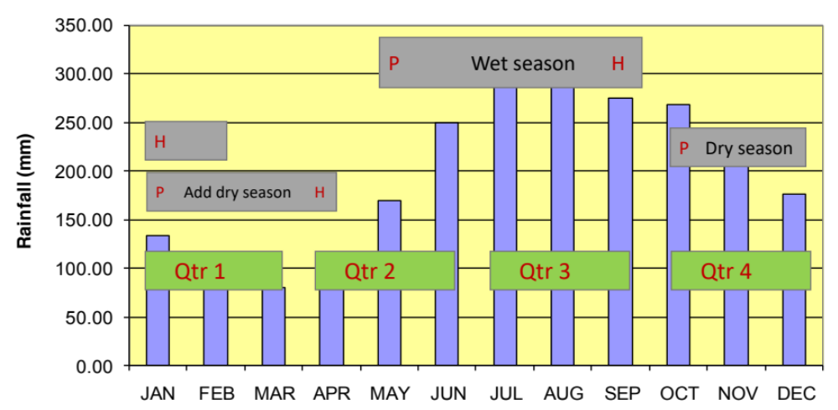
Factors affecting production
Weather patterns
    Nationally, bi-modal rainfall pattern: wet season usually starts in May/June and dry season starts in October/November
Source: PAGASA
30-Year Monthly Rainfall Average in the Philippines

Slide 15
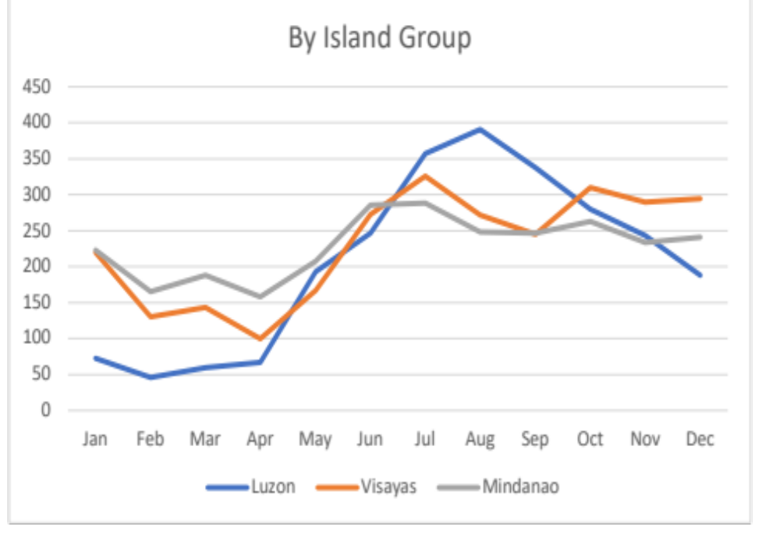
Rainfall distribution
(mm)
Month
Month
Comparative Rainfall Pattern by Island Group
Mindanao (gray) has broader cropping window compared to Luzon (blue). Visayas (orange) is intermediate. Hence Mindanao is touted as breadbasket of the country.

Slide 16
Planting in May/June harvested in Aug/September (Q3)
Planting in October/November harvested in Jan/Feb (Q1)
Planting in Jan harvested in April

Slide 17
Source: PSA, 2019
Percent share of production between the dry and wet seasons, Philippines 2014-2018
Issues Paper on Corn Industry
in the Philippines

Slide 18
  Genotype (Variety)
    Seeds
      Can either be open-pollinated variety (OPV) or hybrid
      Advances in genetics allow introducing genes for specific traits in the parent material through genetic engineering
      Development of genetically modified (GM) seeds has led to an increase in yellow corn productivity (19% yield increase, 10% cost reduction, 8% increase in farm income – STRIVE 2012)
Issues Paper on Corn Industry
in the Philippines

Slide 19
Source: PSA, 2020
Trends in yellow corn production and area harvested, 1975-2019

Slide 20
    Environment
      Refers to conditions where the crop is grown
      Production potential of a variety is dependent on soil fertility management, which calls for more intensive fertilization practices and entails increased fertilizer expenditure
Issues Paper on Corn Industry
in the Philippines

Slide 21
Imports - reasons, sources, prospects and effect on local production
Source: PSA 2019
Trends in domestic corn production, domestic corn used for feeds, and imported corn used for feeds, 2000-2017

Slide 22
Imports - reasons, sources, prospects and effect on local production
Understanding Feed Wheat
Wheat is the most widely grown food crop in the world and it is a temperate crop i.e. not adapted in tropical environments
Two types of wheat: winter wheat and spring wheat - harvested during our 2nd and 4th quarter; with proper storage, feed wheat can therefore be available throughout the year
Grains are milled into flour and used to make bread and other food products

Slide 23
Imports - reasons, sources, prospects and effect on local production
Understanding Feed Wheat
“Wheat available for use in animal feed is typically a feed-grade wheat and is often the portion rejected for human food production…..”
A relatively poor-quality grain cannot be stored for long: when feed wheat comes in, it has to be used soonest.

Slide 24
Imports - reasons, sources, prospects and effect on local production
Understanding Feed Wheat
The Philippines imports feed wheat every month and therefore, when local corn harvest coincides with the arrival of feed wheat, the price of local corn is usually depressed
This is a more pronounced during the 3rd quarter when the Philippines has the big bulk of local harvest and the quality of which is affected by lack of mechanical dryers.

Slide 25
Importation of corn and feed wheat
Source: PSA and USDA data
Domestic production, corn imports, and feed wheat imports from 1987-2018 (cumulative figures, in ‘000 metric tons)

Slide 26
Importation of corn and feed wheat
Source: UN Comtrade Data, 2019
Philippine corn imports by country of origin, in percent shares, 2018

Slide 27
Importation of corn and feed wheat
Source: UN Comtrade data, 2018 and PAFMI
Feed wheat imports of the Philippines by country of origin, 2014-2018

Slide 28
    Private sector imports yellow corn formerly through the National Food Authority (NFA)
    Imports are sourced mainly from United States, Argentina, and ASEAN member countries
    Wheat imports rose dramatically from 5.7 million tons in 2017 to 7.1 million tons (24 percent) in 2018 and the increase is attributable to increase in feed wheat demand in the country
    Wheat is imported all throughout the year
Issues Paper on Corn Industry
in the Philippines

Slide 29
Philippine feed wheat imports by quarter
Year | Quarter 1 | Quarter 2 | Quarter 3 | Quarter 4 | Total
2014 | 87,000 | 141,340 | 425,179 | 496,292 | 1,149,811
2015 | 520,223 | 461,914 | 415,563 | 481,948 | 1,879,648
2016 | 316,703 | 797,966 | 489,092 | 604,429 | 2,208,190
2017 | 640,821 | 827,415 | 560,994 | 442,125 | 2,471,355
2018 | 638,295 | 781,130 | 811,730 | - | 2,231,155
Source: UN Comtrade Data and PAFMI, various years, 2018 data is untill 3rd quarter only
Wheat imports of the Philippines by month, and its timing with local corn harvest

Slide 30
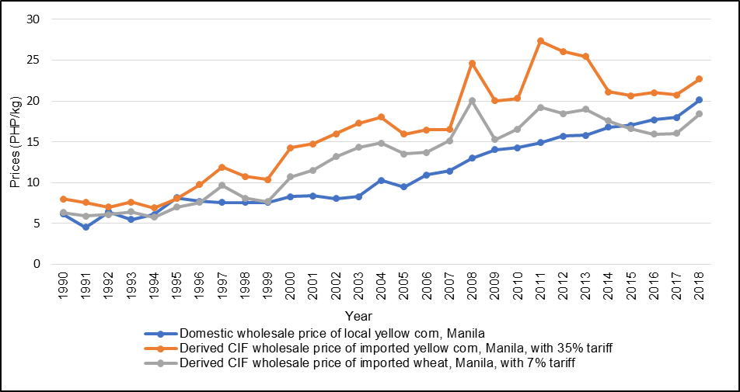
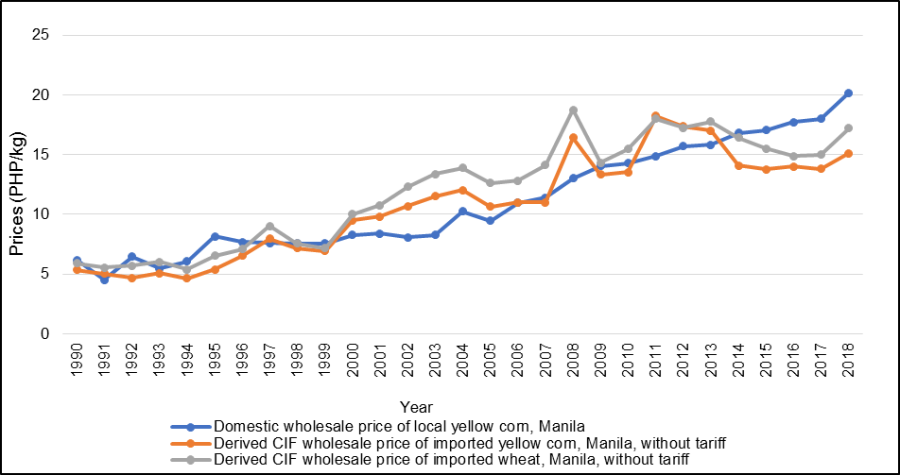
Trends in yellow corn and wheat prices, 1990-2018
Source of basic data: World Bank Commodity Pink Sheet, 2019; Rice and Corn Situation and Outlook Bulletin, various years, 2019; and Tariff Commission of the Philippines, 2019
Source of basic data: World Bank Commodity Pink Sheet, 2019; Rice and Corn Situation and Outlook Bulletin, various years, 2019; and Tariff Commission of the Philippines, 2019
with tariff
without tariff
Comparative price (yearly average) of domestic corn (blue), imported corn (orange) and feed wheat (gray). Lately, with tariff, feed wheat has become cheaper than domestic and imported corn with tariff. Without tariff, imported corn is cheaper than feed wheat and domestic corn. After covid, what happens to international trade?

Slide 31
    Local farm gate prices of corn go down even if international market prices might be high; this is primarily due to the lack of storage capacity when import delivery (corn and/or feed wheat) coincides with local harvest (KIIs)
    Lower price (and income) dampens the interest and capacity of farmers to plant the next season hence feed millers have to buy high the next time around because of reduced local supply
    This explains the boom and bust cycle in the Philippine yellow corn industry; but with more feed wheat imports, yellow corn farm gate prices might continue to be in a bust.
Issues Paper on Corn Industry
in the Philippines

Slide 32
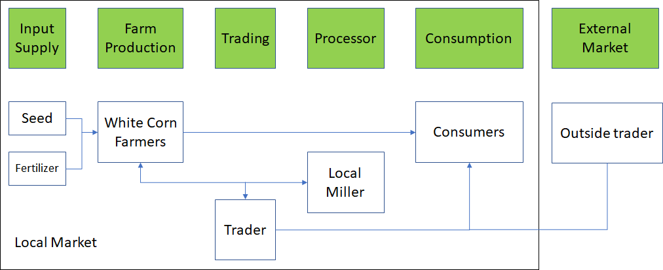
Supply chain and role of stakeholders
(1) White Corn Supply Chain in Cebu

Slide 33
White Corn Supply Chain in Cebu
  Production inputs are readily available within the municipality
  White corn production in Cebu is classified as subsistence farming
  Supply chain is relatively short
  Mills serve as service providers
  White corn grits in Metro Cebu is sourced from Mindanao
Issues Paper on Corn Industry
in the Philippines

Slide 34
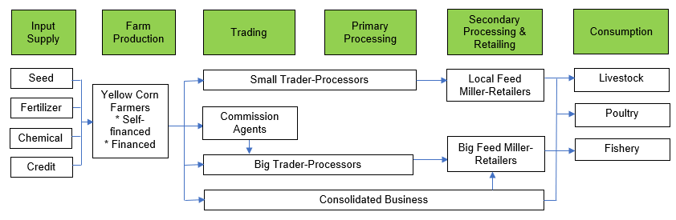
(2) Yellow Corn Supply Chain in Isabela
Breakdown of the consumer's peso from yellow corn grain to feed, Isabela
Chain player | Buying price (PHP/kg feed basis) | Selling price (PHP/kg feed basis) | Marketing margin (PHP/kg feed basis) | Breakdown of consumer’s peso
Farmer | 0.00 | 7.30 | 7.30 | 0.33
Trader-Processor | 7.30 | 8.05 | 0.75 | 0.03
Feedmiller-Retailer | 8.05 | 22.00 | 13.95 | 0.63

Slide 35
Yellow Corn Supply Chain in Isabela
  Major production costs are material inputs
  Majority of the seed market is dominated multinationals: Syngenta, Pioneer, and Monsanto
  Farmers will either self-finance their farm operations or will avail of credit from trader-financiers
  Farmers located in far flung areas must rely on traders to transport their produce to local markets
Issues Paper on Corn Industry
in the Philippines

Slide 36
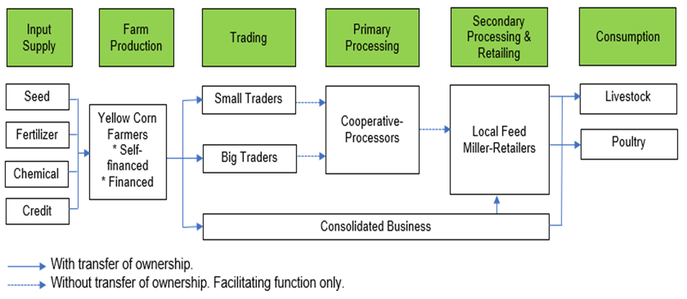
(3) Yellow Corn Supply Chain in Bukidnon
Breakdown of the consumer's peso from yellow corn grain to feed, Bukidnon
Chain Player | Buying Price (PHP/kg feed basis) | Selling Price (PHP/kg feed basis) | Marketing Marginª (PHP/kg feed basis) | Breakdown of Consumer's Peso
Farmer | 0.00 | 6.00 | 6.00 | 0.25
Trader | 6.00 | 6.25 | 0.25 | 0.01
Cooperative-Processor | 6.25 | 6.35 | 0.10 | 0.004
Feed miller-Retailer | 6.35 | 24.00 | 17.65 | 0.74

Slide 37
Yellow Corn Supply Chain in Bukidnon
  Major production costs are material inputs.
  Popular seed brands in the surveyed area are Pioneer, Bioseed, Evogene, and Maharlika
  Farmers will either self-finance their farm operations or will avail of credit from trader-financiers
  Farmlands in the areas can be rented to multinational companies not planting corn
  Cooperative-processors facilitates the flow of yellow corn through the supply chain
Issues Paper on Corn Industry
in the Philippines

Slide 38
(4) Pricing and costing at each level of supply chain
a. Pricing and Costing of Seed Production
Cost of developing Bt corn in the Philippines by major activity grouping, 2004
Area/Activity | Cost (PHP) | Share (%)
Laboratory/greenhouse (US) | 5,199,741 | 4.1
Greenhouse (Philippines) | 1,988,113 | 1.5
Confined field trial (1999-2000 trials) | 7,009,088 | 5.5
Multi-location field trial (2000-2002 activities) | 44,379,128 | 34.7
Commercial propagation (2002 studies/activities, public info sheets and application fee) | 16,312,461 | 12.8
Post-commercial application (2003-2004 activities and 2003-2004 promotion material) | 53,088,637 | 41.4
Total | 127,977,169 | 100
Source: Manalo and Ramon, 2007
Issues Paper on Corn Industry
in the Philippines

Slide 39
b. Pricing and Costing of Yellow Corn Grain Production
Cost and Return of GM and Conventional Corn Production,
Isabela, 2018
Item | Yellow Corn
 | GM Hybrid Corn (PHP) | Conventional Hybrid Corn (PHP)
A. LABOR (land prep, crop establishment, care and maintenance and post harvest activities) | 20,228.00 | 23,160.00
B. MATERIALS | 34,098.00 | 25,560.00
Seeds | 10,900.00 | 5,000.00
Herbicide | 1,100.00 | 350.00
Fertilizer | 12,750.00 | 12,750.00
Insecticide | 1,000.00 | 1,000.00
Sacks | 3,288.00 | 2,700.00
Twines and Needle | 60.00 | 60.00
Miscellaneous (snacks, meals , etc) | 5,000.00 | 3,000.00
C. TOTAL COST OF PRODUCTION | 54,326.00 | 48,720.00
D. YIELD
Yield per hectare | 7,000 | 6,000
Selling Price per kilogram | 19.00 | 19.00
Source: Cagayan Valley Research Center, 2019

Slide 40
c. Pricing and Costing of Yellow Corn Grain Trading
Operating and investment requirements of yellow corn traders per 1,000 kilograms of yellow corn sold, Isabela, 2019
Items | Per 1,000 kg of yellow corn sold
 | Values (PHP) | % Share*
OPERATING COSTS
Yellow corn bought | 13,060.71 | 56.64
Hired labor and transportation | 10,000.00 | 43.36
TOTAL OPERATING COSTS | 23,060.71 | 100.00
INVESTMENT COSTS
Trucks | 2,500,000.00 | 97.09
Floor weighing scale | 75,000.00 | 2.91
TOTAL INVESTMENT COSTS | 2,575,000.00 | 100.00
Source: Elca et al , 2020
Issues Paper on Corn Industry
in the Philippines

Slide 41
d. Pricing and Costing of Feed Milling
Operating and investment requirements of feed millers per 1,000 kilograms of feeds produced, Cagayan and Pampanga, 2019
Items | Per 1,000 kg of feeds produced
 | Small-scale in Cagayan |  | Large-scale in Pampanga
 | Values (PHP) | % Share* | Values (PHP) | % Share*
OPERATING COSTS
Yellow corn bought | 8,051.20 | 33.32 | 5,250.00 | 1.02
Wheat | - | - | 1,580.00 | 0.31
Pollard | - | - | 1,520.00 | 0.29
Soya | 7,020.00 | 29.05 | 2,380.00 | 0.46
Copra | - | - | 1,250.00 | 0.24
Corn bran | - | - | 1,550.00 | 0.30
Rice bran | - | - | 1,500.00 | 0.29
Medicine | 15.00 | 0.06 | 1,500.00 | 0.29
Darak and molasses | 2,336.00 | 9.67 | - | -
Business permits | - | - | 500,000.00 | 96.80
Electricity and water bills | 5,500.00 | 22.76
Sacks | 240.00 | 0.99 | - | -
Other costs | 1,000.00 | 4.14 | - | -
TOTAL OPERATING COSTS | 24,162.20 | 100.00 | 516,530.00 | 100.00
INVESTMENT COSTS
Warehouse | 500,000.00 | 38.46 | 50,000,000.00 | 61.09
Pelletizer | - | - | 5,000,000.00 | 6.11
Crumbler | - | - | 5,000,000.00 | 6.11
Boiler/feed miller | 800,000.00 | 61.54 | 3,000,000.00 | 3.67
Trucks | - | - | 14,850,000.00 | 18.14
Truck scale | - | - | 2,000,000.00 | 2.44
Silo | - | - | 2,000,000.00 | 2.44
TOTAL INVESTMENT COSTS | 1,300,000.00 | 100.00 | 81,850,000.00 | 100.00
Source: Elca et al, 2020

Slide 42
C. Possible competition issues
  Inputs
Breakdown of the farmer costs for yellow corn grain, GM hybrid, Isabela
Input | Cost (PHP/hectare) | Percent share to total cost
Seeds | 10,900 | 20
Fertilizer | 12,750 | 23
Labor | 20,228 | 37
Other Inputs | 10,448 | 20
Total Cost | 54,326 | 100
ª Includes herbicide, insecticide, sacks, and food cost
Source: Cagayan Valley Research Center, 2019
Seeds, fertilizer and labor accounts for 80% of the total production cost of GM hybrid corn farming.

Slide 43
C. Possible competition issues
  Seeds
    Multinational seed companies (Pioneer – Dupont, Monsanto-Beyer, and Syngenta-China Chem) distribute their products through trader-financiers and/or agricultural supply dealers.
    The average expenditure on seeds has increased from PHP 3,000/ha in 2009 to over PHP 10,000/ha in 2018 (PSA)
    Local seed producers need licenses from multinational companies to produce accredited GM seeds.
    Restrictive pricing of accredited GM seeds leads to the proliferation and use of “sige-sige” or “ukay-ukay” seeds (KIIs, 2019)
Issues Paper on Corn Industry
in the Philippines

Slide 44
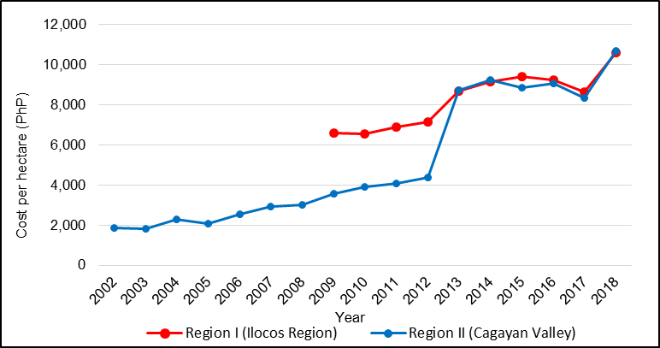
Possible competition issues
Seed Company
Distributor
Retailer
Farmer
Distribution of seeds from seed producer to farmers
Source: PSA, 2019
Average seed costs paid in cash by yellow corn farmers from Region 1 and 2

Slide 45
Possible competition issues
  Fertilizer
    No evidence for “localized monopolies” (PIDS studies: Briones, 2016 and Galang, 2017)
    Regional price differences can be attributed to logistics-related costs
  Corn Output
    Feed millers are able to import corn and other substitutes at anytime within the year in search of lower cost.
    Producers are forced to settle for the best price available to them.
Issues Paper on Corn Industry
in the Philippines

Slide 46
D. Policies and Regulations relevant to possible competition issues
  RA 7308 or Seed Industry Development Act
    New varieties have to undergo series of tests and pass the standards before they get accredited
    Farmers need not patronize those accredited varieties, but they are left to their own resources and risks
Issues Paper on Corn Industry
in the Philippines

Slide 47
Policies and Regulations relevant to possible competition issues
  RA 9168 or Plant Variety Protection Act (PVPA) and Joint Department Circular No. 1 (2016) or JDC No. 1 (2016)
    PVP certificate holders have the right to authorize the following:
      a. Production or reproduction
      b. Conditioning for the purpose of propagation
      c. Offering for sale
      d. Selling or other marketing
      e. Exporting
      f. Importing
      g. Stocking for any purpose mentioned above
    - In JDC No. 1 (2016), the owner of the technology owner could always renew their application to commercialize their technology every five years
Issues Paper on Corn Industry
in the Philippines

Slide 48
Policies and Regulations relevant to possible competition issues
  Markets for Local Corn
    The minimum access volume (MAV) as a means to ensure international trade and support local corn industry
    Importers can avail a lower import duty of 5 percent if the produce comes from any ASEAN-member country. Report of trans shipment from high tariff country to low tariff country.
    Yellow corn and feed wheat import trade is liberalized, anyone can now import
    Importation is essentially open, but export is not
    Tariff collected from importations supposedly meant to directly address the capability needs of local corn farmers like post-harvest and various field production needs.
Issues Paper on Corn Industry
in the Philippines

Slide 49
IV. Summary, Conclusion and Recommendations
Summary and Conclusions
  Corn grows all over the country, but some regions excel more than others. We have the potential to produce more
  Supply and demand for yellow corn is growing, and local yield levels are comparable to neighboring Asian countries
  Yellow corn and feed wheat are imported to address the gap in local supply
Issues Paper on Corn Industry
in the Philippines

Slide 50
  Summary and Conclusions
  Productivity of white corn has remained low and flat due to limited demand
  Reducing seed costs can help lower the production cost for corn
  Open access to expired patented GMO genes could help in developing cheaper but still good quality seeds from the local hybrid corn seed developers
Issues Paper on Corn Industry
in the Philippines

Slide 51
  Summary and Conclusions
  Some importers use trans shipping via ASEAN countries to work around the MAV tariffs.
  The corn sector also cannot depend only on a market which has the capability to source other cheaper substitutes. Local corn cannot be exported even if niche opportunity exists in nearby Asian countries. Contrary to spirit of liberalized trading in RA 11203 which allocated also the tariff to support needs of local farmers.
Issues Paper on Corn Industry
in the Philippines

Slide 52
Recommendations relevant to PCC mandate
(1) liberalize corn export and
(2) free up the gmo corn technology to local seed companies.
In the course of importations, past and future, the said tariff should be automatically allocated to directly provide for the field equipment and post-harvest needs of the farmers including development of other productivity-enhancing technologies.
Issues Paper on Corn Industry
in the Philippines

Slide 53
ASPSI CONSULTANT TEAM
Dr. Artemio M. Salazar, Principal Investigator cum Corn Expert
Prof. Cenon D. Elca, Agricultural Economist cum Supply Chain Analyst
Prof. Geny F. Lapiña, Agricultural Economist cum Policy Development Specialist
Mr. Francis Joshua D. Salazar, Research Associate
Issues Paper on Corn Industry
in the Philippines

Slide 54

Thank
You!!

Slide 55
RA 9168 Plant Variety Protection Law
Section 2 (b) Statement of Policies
a) The State recognizes that an effective intellectual property system in general and the development of new plant variety in particular is vital in attaining food security for the country. To this end, it shall protect and secure the exclusive rights of breeders with respect to their new plant variety particularly when benedcial to the people for such periods as provided for in this Act.
b) The use of intellectual property bears a socio-economic function. To this end, State shall promote the diffusion of technology and information for the promotion of national development and progress for the common good.
c) The State recognizes the indispensable role of the private sector, encourages the participation of private enterprises and provides incentives to needed investments in the development of new plant varieties.
d) The State recognizes that science and technology are essential for national development and promotes the adaptation of technology and knowledge from all sources for the national benefit. The State also recognizes the need to protect and secure the exclusive rights of scientists and other gifted citizens to their intellectual property and creations.
e) The State, while recognizing intellectual property rights in the deld of agriculture, does so in a manner supportive of and not inconsistent with its obligation to maintain a healthful ecology in accord with the rhythm and harmony of nature.

Slide 56
Philippine Constitution
Section 9. The State shall develop a self-reliant and independent national economy effectively controlled by Filipino

Slide 57
 | Yellow corn production ¹ | Yellow corn imports ² | Estimated feed wheat imports ³ | TOTAL Major Feed Ingredients Supply
1987 | 1,513 | 85 | 391 | 1,989
1988 | 1,569 | 50 | 415 | 2,034
1989 | 1,599 | 370 | 463 | 2,432
1990 | 1,888 | 115 | 521 | 2,524
1991 | 1,749 | - | 607 | 2,356
1992 | 1,919 | - | 698 | 2,617
1993 | 2,171 | 1 | 791 | 2,963
1994 | 2,429 | 136 | 721 | 3,287
1995 | 2,266 | 516 | 693 | 3,475
1996 | 2,268 | 367 | 762 | 3,397
1997 | 2,453 | 325 | 686 | 3,464
1998 | 2,203 | 129 | 815 | 3,147
1999 | 2,761 | 582 | 1,044 | 4,386
2000 | 2,622 | 246 | 1,068 | 3,935
2001 | 2,607 | 243 | 1,023 | 3,873
2002 | 2,522 | 102 | 1,131 | 3,755
2003 | 2,563 | 52 | 1,041 | 3,656
2004 | 3,186 | 157 | 908 | 4,251
2005 | 3,002 | 321 | 1,037 | 4,360
2006 | 3,721 | 163 | 965 | 4,850
2007 | 4,209 | 58 | 794 | 5,061
2008 | 4,674 | 432 | 1,122 | 6,228
2009 | 4,718 | 118 | 1,119 | 5,955
2010 | 4,208 | 61 | 1,128 | 5,397
2011 | 4,821 | 203 | 1,408 | 6,432
2012 | 5,242 | 92 | 1,267 | 6,601
2013 | 5,248 | 741 | 1,217 | 7,206
2014 | 5,508 | 623 | 1,150 | 7,281
2015 | 5,384 | 742 | 1,880 | 8,006
2016 | 5,196 | 609 | 2,208 | 8,013
2017 | 5,811 | 724 | 2,230 | 8,764
2018 | 5,627 | 675 | 2,641 | 8,943

Slide 58
 | % Domestic corn production | Yellow corn import share | Feed wheat share
1987 | 76% | 4% | 20%
1988 | 77% | 2% | 20%
1989 | 66% | 15% | 19%
1990 | 75% | 5% | 21%
1991 | 74% | 0% | 26%
1992 | 73% | 0% | 27%
1993 | 73% | 0% | 27%
1994 | 74% | 4% | 22%
1995 | 65% | 15% | 20%
1996 | 67% | 11% | 22%
1997 | 71% | 9% | 20%
1998 | 70% | 4% | 26%
1999 | 63% | 13% | 24%
2000 | 67% | 6% | 27%
2001 | 67% | 6% | 26%
2002 | 67% | 3% | 30%
2003 | 70% | 1% | 28%
2004 | 75% | 4% | 21%
2005 | 69% | 7% | 24%
2006 | 77% | 3% | 20%
2007 | 83% | 1% | 16%
2008 | 75% | 7% | 18%
2009 | 79% | 2% | 19%
2010 | 78% | 1% | 21%
2011 | 75% | 3% | 22%
2012 | 79% | 1% | 19%
2013 | 73% | 10% | 17%
2014 | 76% | 9% | 16%
2015 | 67% | 9% | 23%
2016 | 65% | 8% | 28%
2017 | 66% | 8% | 25%
2018 | 63% | 8% | 30%
 | 72% | 6% | 23%

